Slide 1



FYP
PLAGIARISM DETECTION SYSTEM FOR URDU LANGUAGE
Syed Ahmed Ali (2579-2021)
Syed Shaheer Ul Haq (2197-2021)
Supervisor:
MR. AAMIR HUSSAIN
Department of Computing, FEST
Hamdard University

Slide 2
Summary
Problem Statement
Objective
FYP Scope
Our methodology
Our Project Plan (Time lines)
Budget / Costing (if any)
FYP Deliverables
References

Slide 3
Problem Statement
Plagiarism, the unauthorized use or close imitation of another's language, thoughts, or ideas, is a serious issue in academic and professional settings. While several plagiarism detection tools exist for English and other widely spoken languages, there is a lack of efficient and accurate tools tailored for Urdu language documents. This project aims to develop a plagiarism detection system specifically designed for Urdu, utilizing a combination of linguistic and statistical techniques to identify instances of plagiarism in Urdu text. The system will be capable of comparing documents and highlighting similarities, providing a valuable tool for educators, researchers, and content creators to maintain originality and academic integrity in Urdu language writing.

Slide 4
Objective
User-Friendly App with Backend AP
Users can upload DOCX, PDF, or TXT files for analysis via a mobile-friendly interface.
Custom BERT Model for Urdu
Trained on academic Urdu datasets (e.g., Islamic studies, environment, media) to detect semantic similarity.
Advanced NLP Preprocessing
Used UrduHack for tokenization, normalization, and stop-word removal to prepare clean input for analysis.
Plagiarism Detection & Reporting
Highlights plagiarized content, calculates similarity scores, and generates downloadable PDF reports.

Slide 5
FYP Scope
This system is specifically designed for processing and analyzing Urdu-language documents by extracting structured text from DOCX, PDF, and TXT files. It uses advanced preprocessing tailored for Urdu, followed by semantic and syntactic similarity detection through a custom-trained BERT model and cosine similarity. A web application built with Flutter enables users to upload documents, view plagiarism results, and download detailed PDF reports. The backend, powered by FastAPI, manages user authentication, file processing, plagiarism detection, and securely stores analysis history for future reference.

Slide 6
Our Methodology
We adopted the VNV Model (Verification and Validation) methodology to ensure systematic and high-quality development. The process began with creating a custom Urdu-language dataset, followed by preprocessing using UrduHack for tokenization, normalization, and stop word removal. We then fine tuned a BERT based deep learning model for semantic similarity detection Each development phase dataset, NLP preprocessing, model training, backend API (FastAPI), and Flutter mobile app was paired with corresponding verification stages like unit, integration, and system testing. This approach ensured early issue detection, accurate plagiarism analysis, and a stable end-to-end solution.

Slide 7
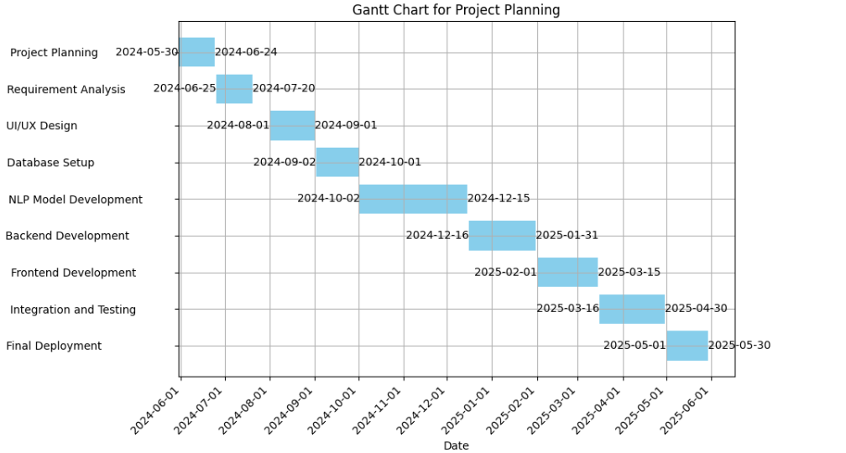
Our Project Plan

Slide 8
FYP Deliverables
FYP-I Evaluation
FYP-II Evaluation
Software requirement specification document
Software requirement specification document
Project Report – I (3 chapters)
Software Demo Video
Test Plan/Test Report
Project Report – II
Git-Hub Repository Link
Running API’s

Slide 9
Reference
"Plagiarism Detection in Urdu Documents using Sentence Structure Analysis" by S. M. Akram Shah et al.
"Urdu Plagiarism Detection using Statistical Features" by M. Naveed Iqbal et al.
"Plagiarism Detection in Urdu Language Documents Using Shallow Semantic Parsing" by M. Yasir Khan et al.
Plagiarism checker Prepostseo from playstore
(https://play.google.com/store/apps/details?id=com.plagiarism_checker.duplicate)

